Slide 1
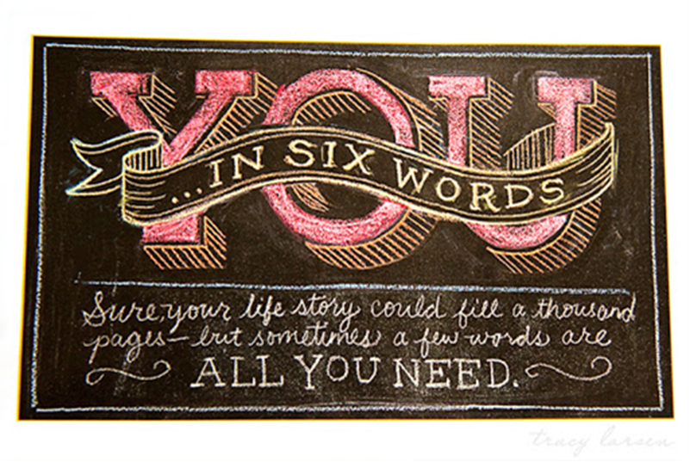
Six Word Memoirs

Slide 2
Six-Word Memoirs: A brief history
Baby shoes: For sale; never worn.
--Ernest Hemingway

Slide 3
Target vocabulary for today’s learning opportunity
Connotation: the emotional or personal associations the word carries, beyond its literal definition
Ex: child, kid, tyke, juvenile, youngster, adolescent
Register: the level of formality or informality associated with the word
Ex: Speak, chat, verbalize, orate, converse, yak, communicate, discuss
Sound and rhythm: the way words sound and scan contribute to their appropriateness

Slide 4
In your groups, discuss the following: Your group is on the hook to answer one of these questions!
What’s the difference between a story and a memoir?
Why do we tell stories?
Who knows your story best?

Slide 5
In your groups, Read the following Examples:
Awkward girl takes chances. Fun ensues. -- Charlotte Riley
I auditioned. I got the part. -- Faith Hoffman
Never lived up to my potential. --Leslie Sterling
Carbohydrates call my name every day. --Mary Petersdorf
Anything possible—but I was tired. --Cheryl Family
Girlfriend is pregnant, my husband said. --Shonna MacDonald
I am awfully bored at work. -- Chris Ponchak
Learned reading, writing, forgot arithmetic. --Elizabeth Rose Gruner
A sundress will solve life’s woes.
--Kristen Grimm
I recognize red flags faster, now. --Barbara Burri
Never should have bought that ring. --Pete Bellows
Stranded by ten-thousand mile crush. --Will Cockrell
College was fun. Damn student loans. --Randy Boland

Slide 6
Discuss the sample memoirs (Choose 2-3 questions).
After reading all the six-word memoirs, what surprises you about this form? What can you learn from it to take to other types of writing?
In your mind what were the most common themes in the collection?
Pick one of the memoirs that you do not understand and discuss what it might mean with your classmates.
Which of these memoirs is the most poignant to you and why? Which is the most tragic and why?
Which is the funniest and why?

Slide 7
Ms. Corrigan’s six-word memoirs.
Arizona State University, top of class.
Teachers should not smile until November.
Twenty-six point two miles, easy.
The gym: my true happy place.
A good book takes me away.
Mint chocolate chip- superior ice cream.
Soon to be married-how exciting

Slide 8
Your turn:
Craft your own six word memoirs:
You can use the three fun facts you wrote down at the beginning of class (but this is not a requirement.)
Choose words that have a specific CONNOTATION, REGISTER, or SOUND/RHYTHYM to them.
Ideas to get you started:
Your best memory, your worst memory, your proudest moment, your most embarrassing moment, an important life lesson you learned, an important person in your life, funny things, your favorite things, least favorite things
Most importantly, have fun and make sure the memoirs tell a story about YOU!
Use your template provided to write 10-15 memoirs.

Slide 9
Sharing out
Share 2-3 of your six-word memoirs you wrote with your group.

Slide 10
Six Word Memoir: The power of language with six words.
Let’s review vocabulary.
Denotation:
Connotation:
Register:

Slide 11
Six Word Memoirs: The power of language with six words.
Let’s review vocabulary.
Denotation: The dictionary (literal) definition of a word.
Connotation: The feelings, emotions, and associations of a word.
Register: formal/informal

Slide 12
Revising
Choose 3 of your OWN memoirs you wish to revise for connotation, register, and sound/rhythm.

Slide 13
The power of language with six words.
Choose three memoirs your think you may want to illustrate. Sketch them out on the template provided.
Rewrite it replacing words for SPECIFIC connotation and register.
Connotation=emotional association (+ or -)
Register=informal/formal

Slide 14
Quick work
Sketch out three (3) of your six-word memoirs on a piece of blank paper.

Slide 15
Question out the door:
Verbally share 1 of the 3 you decided to revise and sketch!

Slide 16
Six Word Memoirs : The power of language with six words.
Take out the 3 memoirs you sketched out for homework.
You should have at least 2 version of EACH memoir—having replaced/altered words for SPECIFIC connotation and register. Each memoir must still contain six words.
Ex: Try taking a humorous memoir and adding a layer of frustration, longing, etc. Or take a series memoir and add a layer of humor.
Connotation= emotional association (+ or -)
Register= informal/formal

Slide 18
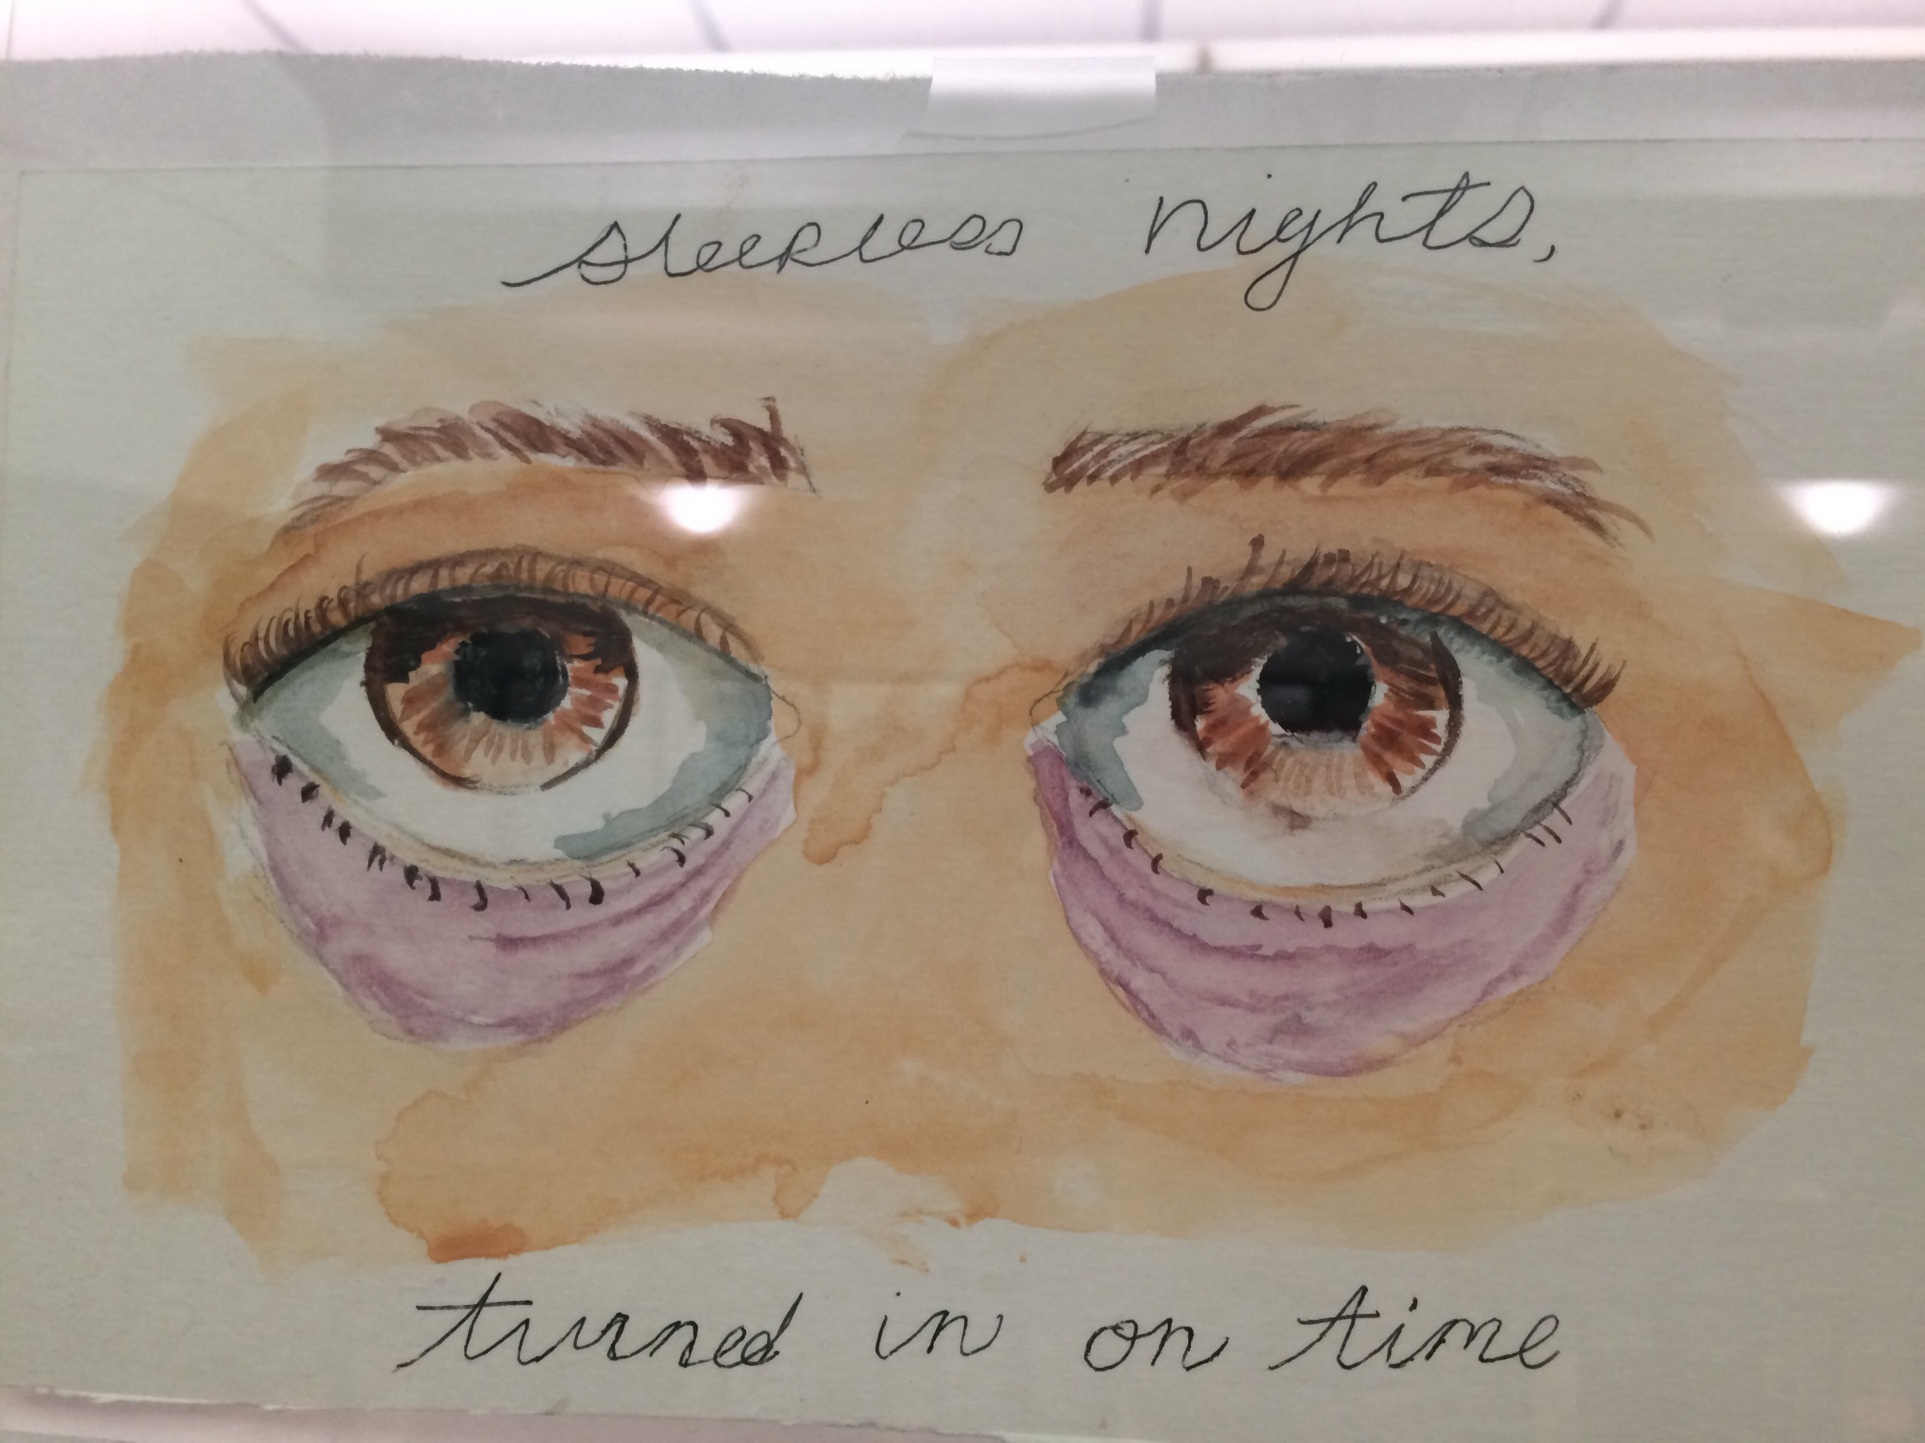

Slide 22
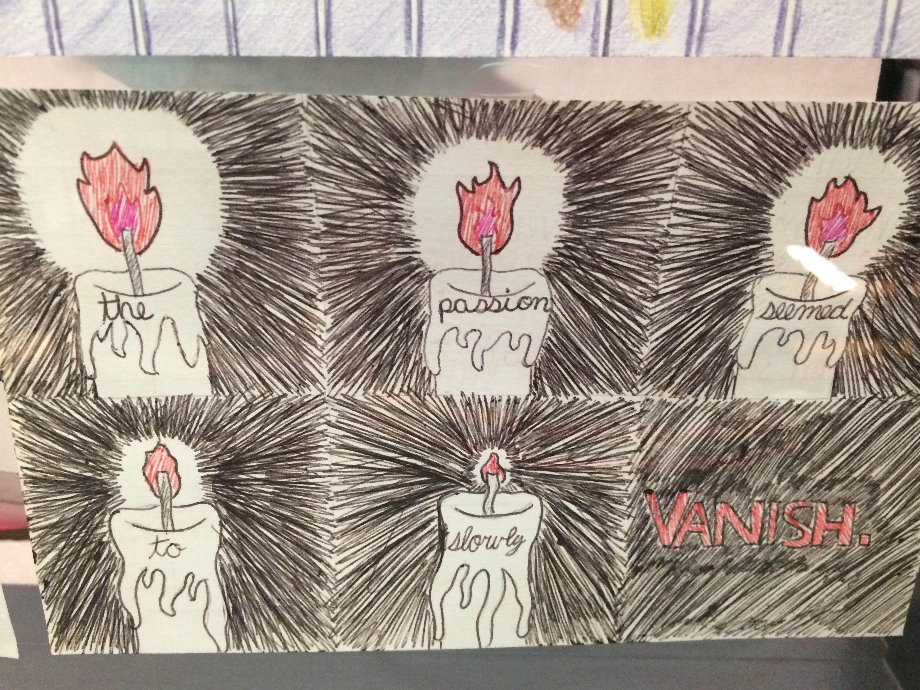

Slide 23
Revised
Share one of your six word memoirs that you revised with your group.
Pick one you want to fully sketch with color and detail on an index card.
On the back of the index card, write your original version of that memoir and a short paragraph discussing what changes you made and why.

Slide 24
Final
Your final Six Word Memoir should be clearly stated an on illustrated index card.
Share your index card with a person near you and compliment one other person’s memoir: this feedback is positive only. Be specific and kind!
Turn in in the your period’s basket!

Slide 25
Six word memoirs/The power of words:
Step 1: Choose your favorite six word memoir. (Original and the one you revised for connotation and register.)
Step 2: In a brief paragraph on the back of the card, describe what you have learned about the importance of word choice in writing through the genre of the six-word memoir. What are the advantages/challenges to this type of writing.
AND… Explain how you used CONNOTATION and/or REGISTER to convey meaning in your writing.

Slide 26
Example of revised memoir and SAP.
Four cats; no plans to stop. (original) People like me don’t get PhDs. (original)
Servant to cats; life is good. (revised) Southside girl: Woman with her doctorate. (revised)
SAP:
Through writing six-word memoirs, I have learned that I can convey a deep meaning with only a few words. I must choose the precise word in order to establish tone and audience immediately. In the first example, the original focuses on the negative. The words “no plans” signifies a negative action, almost rebellious. In my revision, I focused on connotations. The revised version uses the word “servant.” The word “slave” would have been too negative and carried negative connotations. The word “servant” can be a positive thing if one enjoys one’s servitude. I revised the negative into a positive at the end when I said “life is good.” This creates what writers call juxtaposition, meaning two conflicting ideas. Being a servant is typically negative, but by saying “life is good,” it is clear I enjoy my feline servitude. The register of my revised version is more formal than the first in the beginning, but ends informally by saying “life is good.” There is a juxtaposition in both register and connotation in this memoir. I learned that using connotation and register thoughtfully helps me convey meaning as a writer.

Slide 27
Timed Writing
Get out final Six-Word Memoirs and turn them into your period’s basket.
Please begin reading the Timed Writing directions and introduction.

Slide 28
Timed Writing
You have the period to read the six sources, pick 3 to incorporate into your argument, and write a 5 paragraph essay responding to the prompt.
You will turn in whatever you complete at the end of the period.

